Slide 1
Lab 1: Communication
Sean Prokop
Winter 2019

Slide 2
Objective
The objective of this lab is to learn how to use IR LEDs and IR receivers, and use a remote to communicate with them. And also use a remote to change the color of an RGB led.

Slide 3
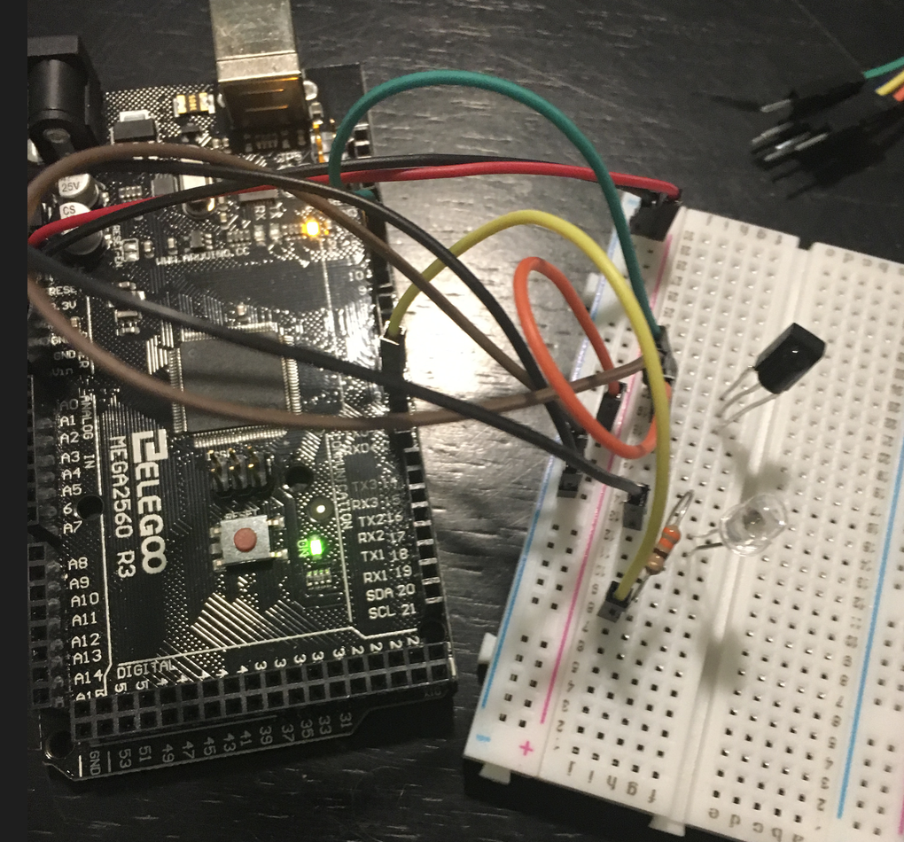
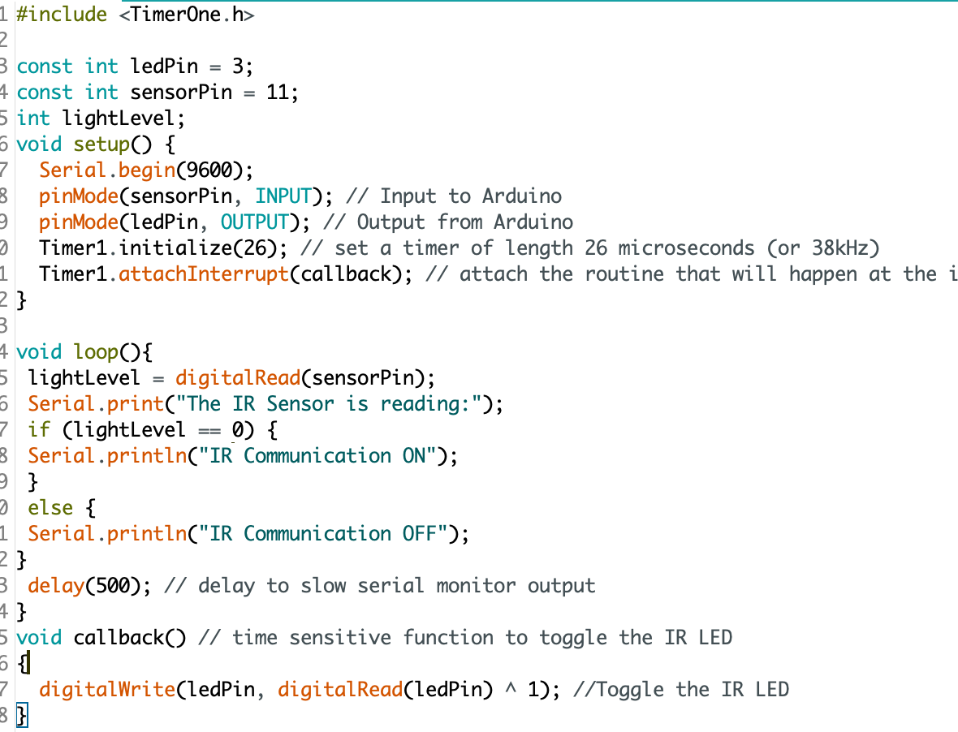
Lab 1: Challenge #1
The setup shows an IR led connected through a resistor to a PWM pin, and the receiver connected to another pin for reading. The code reads the IR sensor every 500ms and toggles the LED every 26us. I toggled the IR led at 38kHz by interrupting it every 26 microseconds which corresponds to a frequency of 38kHz (1/26us = 38kHz). This is important because IR communication is standardized to that frequency so it reads at that frequency.

Slide 4
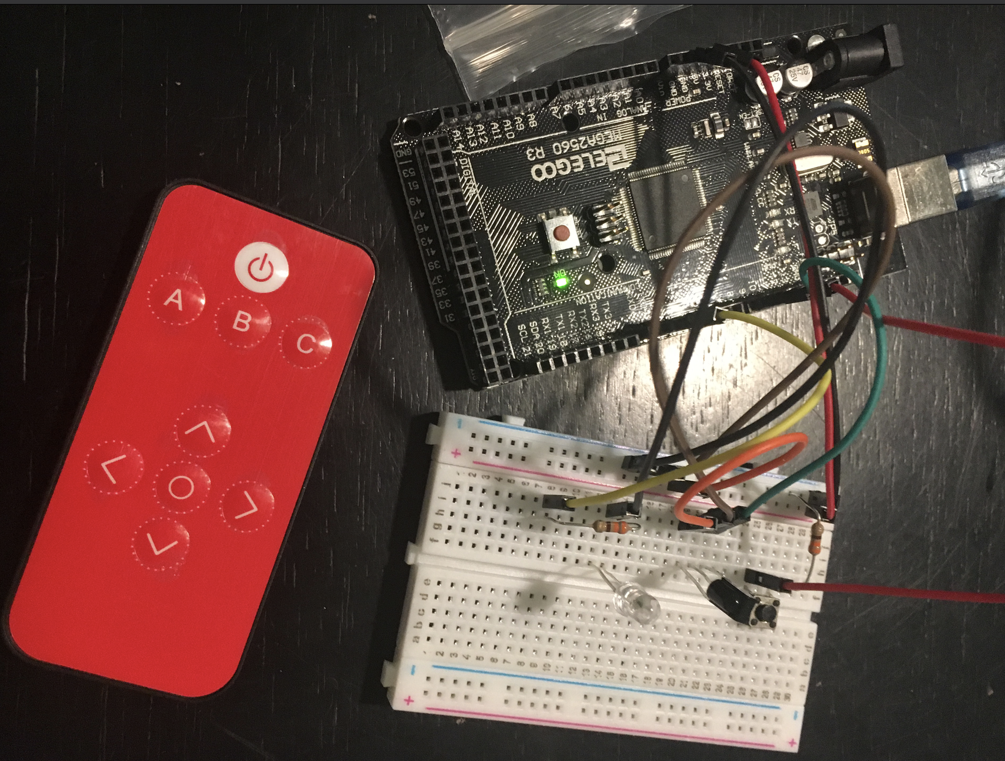
Lab 1: Challenge #2
This setup has an IR led and a receiver with a button. Each button press on the remote sends a hex code to the Arduino and when the button is pressed it sends that signal on the IR led that can be used to control other electronics.

Slide 5
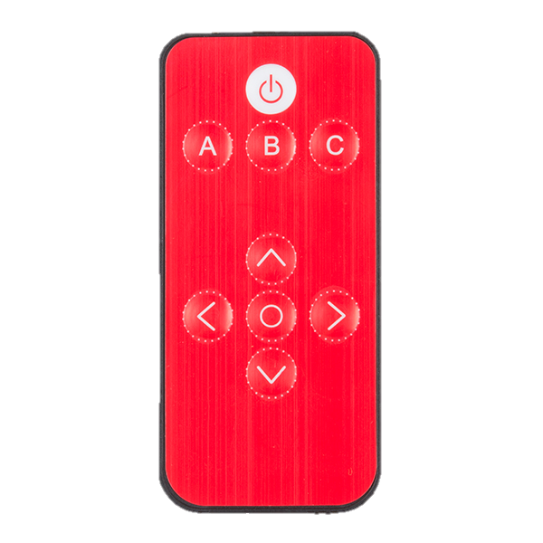


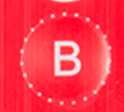






Lab 1: Challenge #2
Paste HEX Code Recorded
(Choose 6 buttons)
Example: 0x10EF0E0F
0xFF629D
0xFF22DD
0xFF02FD
0xFFC23D
0xFF9867
0xFF30CF
0xFF18E7
0xFF7A85
0xFF38C7

Slide 6
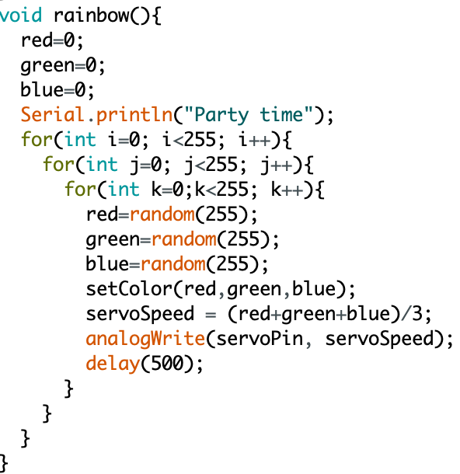
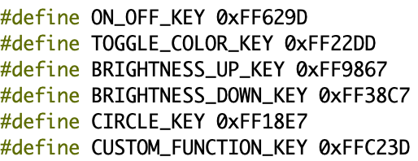
Lab 1: Challenge #3

Slide 7
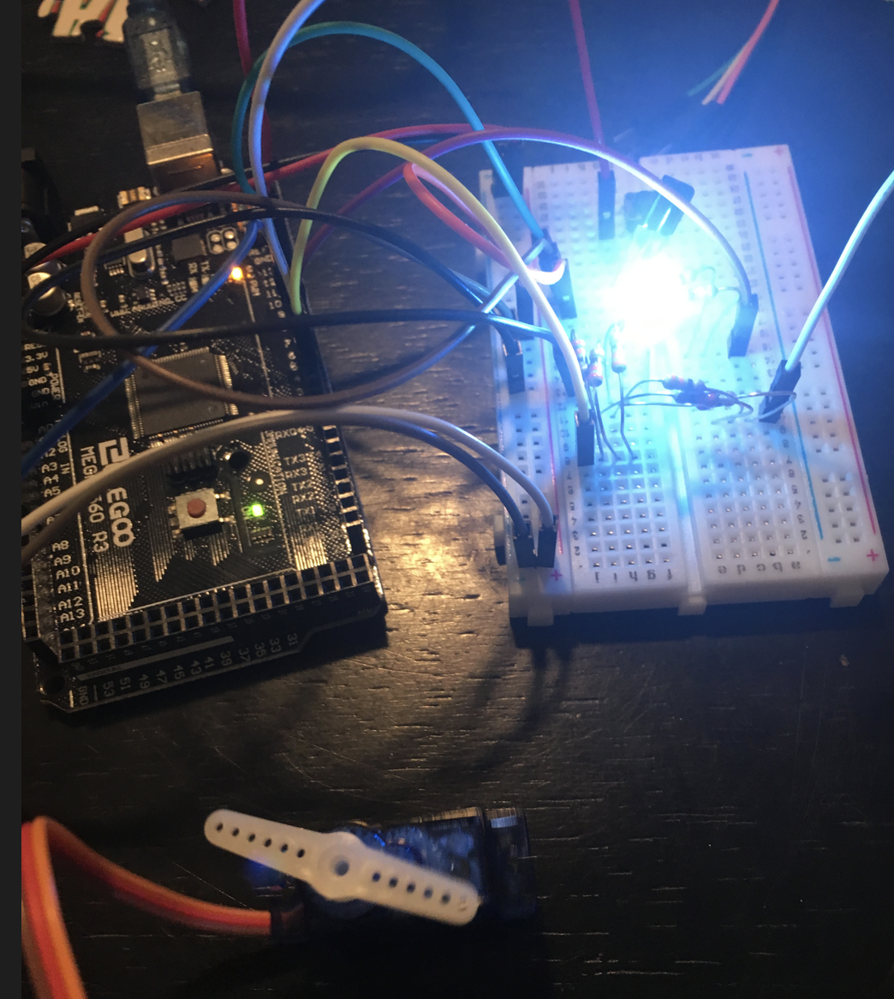
Challenge #3
What did you learn? Most was stuff I had learned in previous classes, but I had never learned how to work with a servo but it was pretty simple to use.
How does an RGB LED work? What is Pulse Width Modulation? RGB led works by setting a specific voltage on each pin that correlates to 0-255 for RGB scale. PWM is varying the period of a square wave to create a signal that parts can react to using the duty cycle.
Explain why an IR LED and receiver work much more effectively than a visible light (LEDs) receiver and transmitter? An IR led is better because it is invisible light so it is not affected by ambient lighting.
This figure shows the RGB led lit to a shade of blue and the servo is in a specific position. The servo moves a specific amount depending on the average of the RGB values.

Slide 8
Experience
The most valuable part of this lab was getting to play with a remote, those are always fun and I remember in ECE 25 my favorite lab was the one with the remote. I didn’t try extending anything I learned in this lab but I am planning on it due to my other project classes this quarter.
I did not take any other pictures for this lab. Another idea to continue on with this is to create functions that could send a specific set of commands to something like a TV using a single button on the remote. I.e. turn the tv on, set the volume to a specific level, set the input to a specific one all at once.

